Slide 1
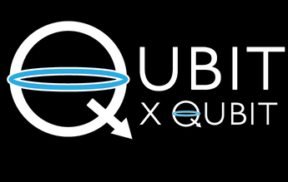

INTRO TO QUANTUM COMPUTING
Week 13 Lab
QUANTUM MECHANICS - 3
Aman Bansal
6th January 2021
© 2020 The Coding School

Slide 2
PROGRAM FOR TODAY
Canvas attendance quiz
Pre-lab zoom feedback
Questions from last week
Lab content
Post-lab zoom feedback

Slide 3
Canvas attendance quiz
Please log into Canvas and answer your lab section’s quiz (using the password posted below and in the chat).
This is lab number: 12A
Passcode: 9646
On a scale of 1-5, how much do you agree/disagree with the following statement: I'm glad we took the time to learn the math concepts inherent to quantum computing.
In general, do you like math?
This quiz not graded, but counts for your lab attendance!

Slide 4
PRE-LAB Zoom FEEDBACK
On a scale of 1 to 5, how would you rate your understanding of this week’s content?
1 –Did not understand anything
2 – Understood some parts
3 – Understood most of the content
4 – Understood all of the content
5 – The content was easy for me/I already knew all of the content

Slide 5
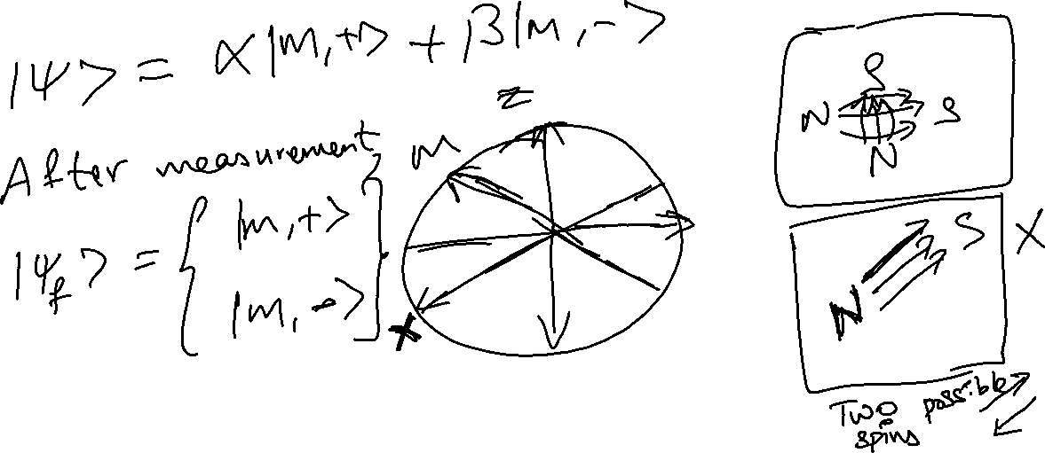
Questions from past week
What if we tried to measure the spin along x and z at the same time?

Slide 6
Learning objectives FOR LAB 13
Understanding the ‘quantum’ in ‘quantum computing’
Waves on a string
Modes and eigenfunctions
Modes in the quantum world
Using the postulates of quantum mechanics
Stern-Gerlach experiment revisited
Applying the postulates to the SG experiment
“Quantum Mechanics” on a guitar string*
*Optional content

Slide 7
motivation
Why are we learning quantum mechanics?
Qubits are made of objects that show wave- and particle-like behavior!
Quantum mechanics is the mathematical description of objects that show such behavior
Qubits and quantum gates are governed by the rules of quantum mechanics
Notes:
Why do we care about quantum mechanics? It is the framework underlying quantum computing. Just like it is helpful to learn the rules of soccer to improve one’s performance, it is useful to learn the rules that all quantum computers follow.

Slide 8
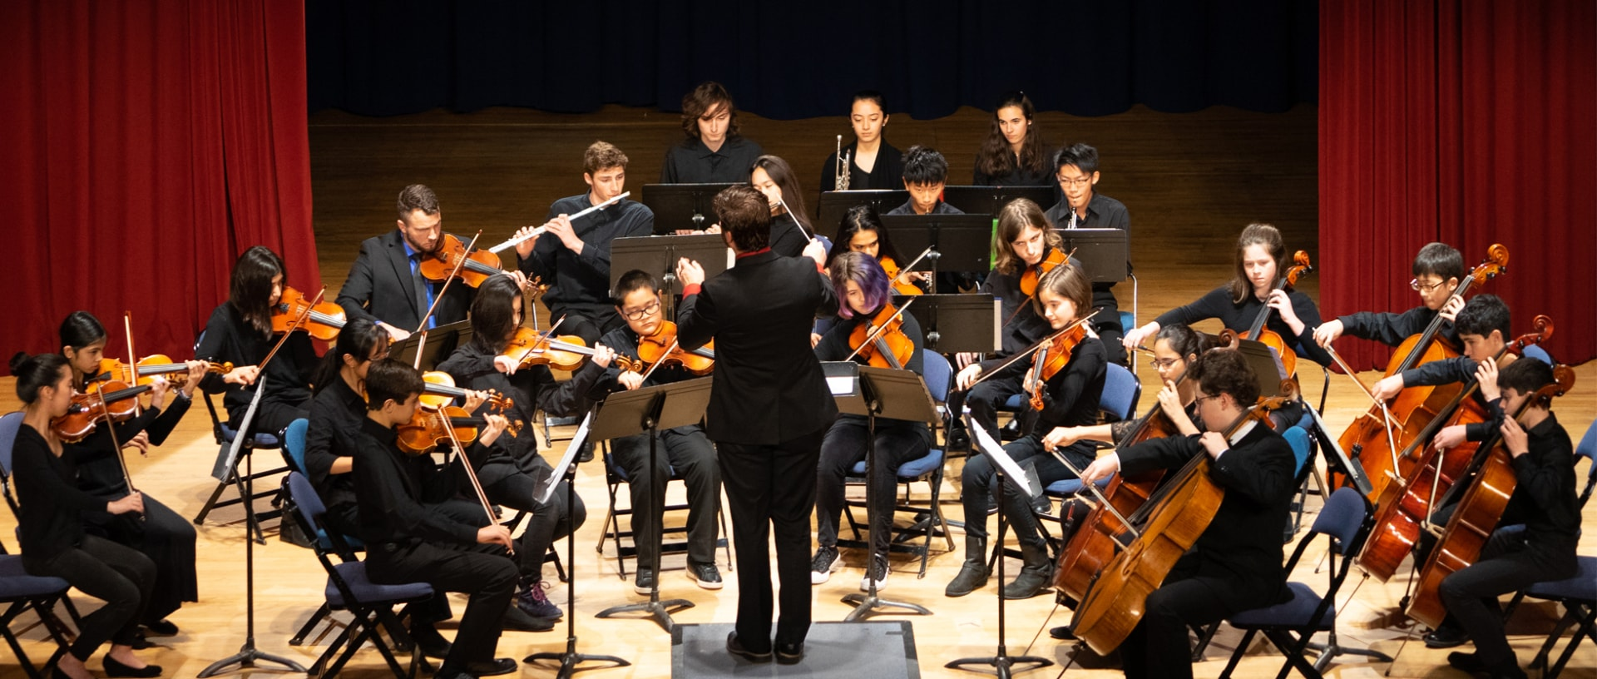


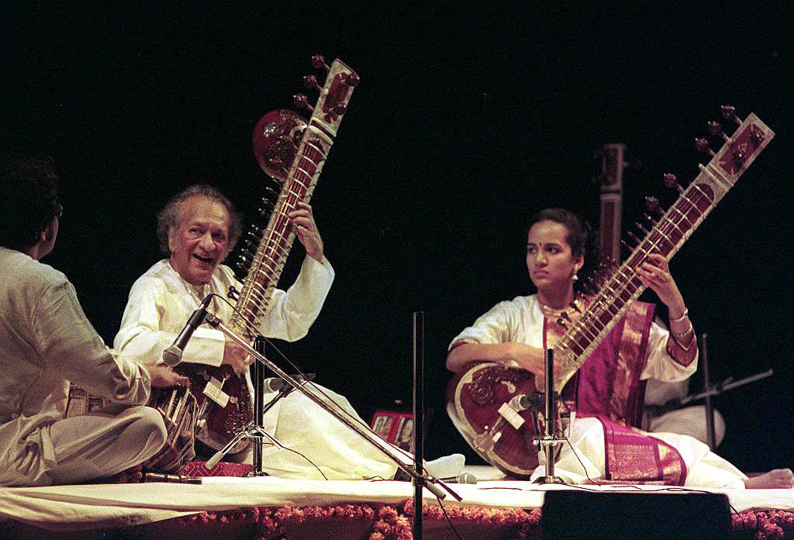

Do you play a musical instrument?

Slide 9
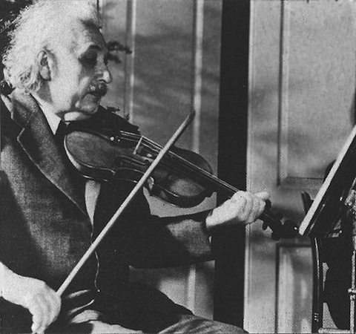
You’ve started your quantum career!
“If I were not a physicist, I would probably be a musician. I often think in music. ... I cannot tell if I would have done any creative work of importance in music, but I do know that I get most joy in life out of my violin.”

Slide 10

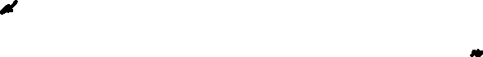
Let’s think about a string
string
fixed
fixed
How does this string look when it vibrates?
Notes:
Let’s thing about a string on a guitar or a violin. Such a string is fixed at two ends, as you can see in the image of the guitar to the right. This string vibrates between two fixed ends. What does the string look like when it vibrates?

Slide 11
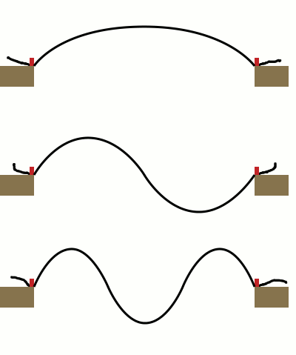
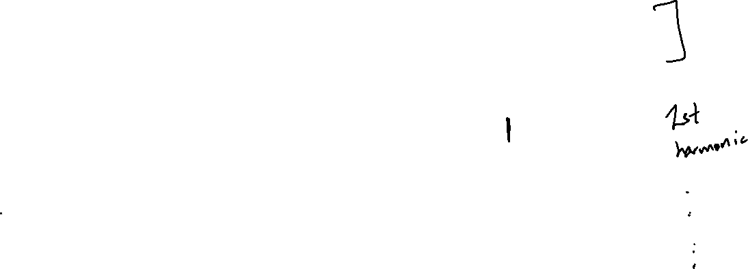
Standing waves
string
fixed
fixed
The string takes on specific shapes when it feely vibrates
These shapes are called modes
Notes:
When the string vibrates freely, there are only certain shapes that it can take. These shapes are called modes.
You might be wondering what we mean by “vibrates freely” – we’ll clarify this in the optional content.
If any of you play the guitar or violin, these modes are called “artificial harmonics”

Slide 12
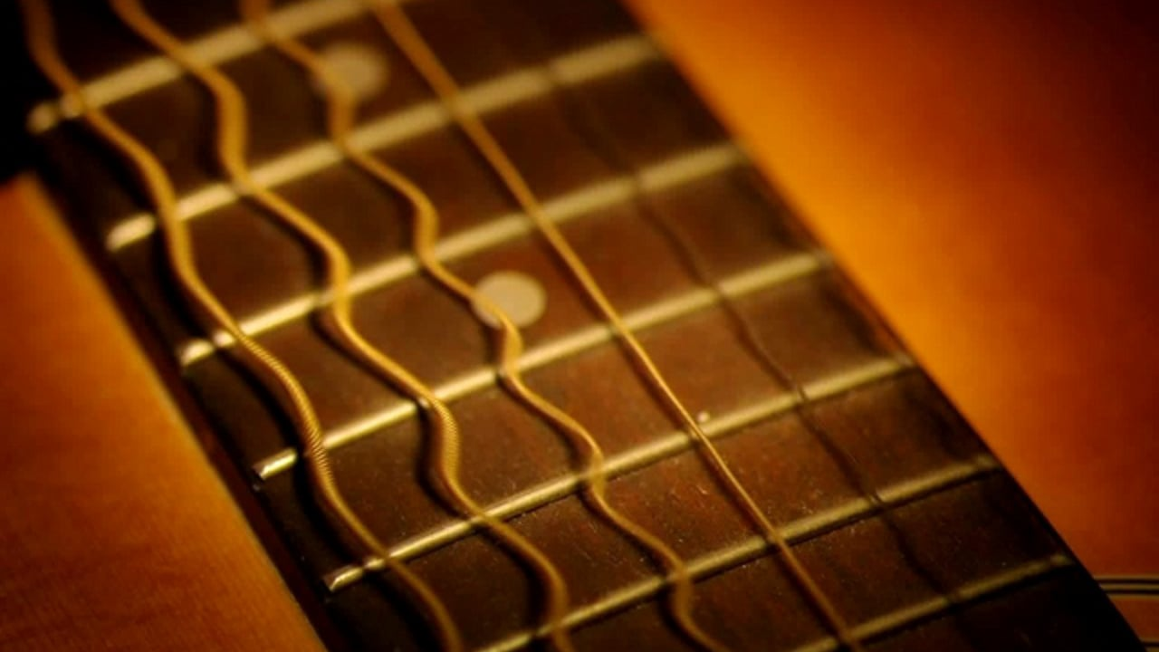
Only some shapes allowed
Modes of guitar strings
string
fixed
fixed
Notes:
Here, you can see some of these modes on guitar strings.

Slide 13
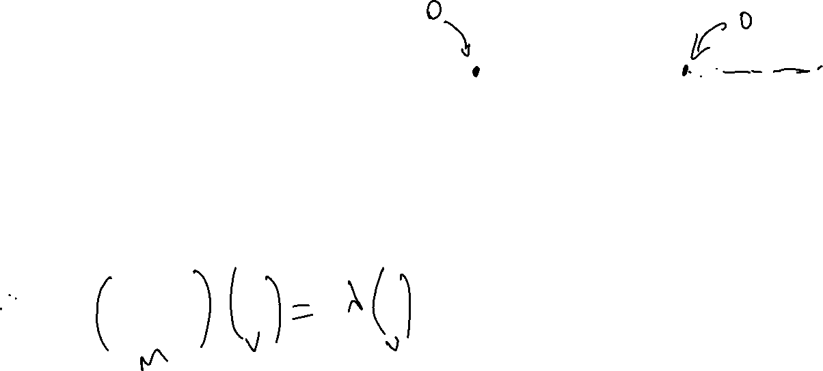
Why only These MODES?
Modes are a result of confinement
The string has to be fixed at two ends
These modes are eigenfunctions!
Notes:
So why does the string only vibrate in these modes? The modes are created because of confinement – the fact that we are clamping the string down at two ends. Imagine trying to “fit” waves into the string with these constraints – how many could you fit? You can only fit a half wave, or a full wave, or 3 halfs of a wave, and so on.
These modes are the eigenfunctions of the string! Eigenfunctions are these “basic” modes that the string can vibrate in.

Slide 14
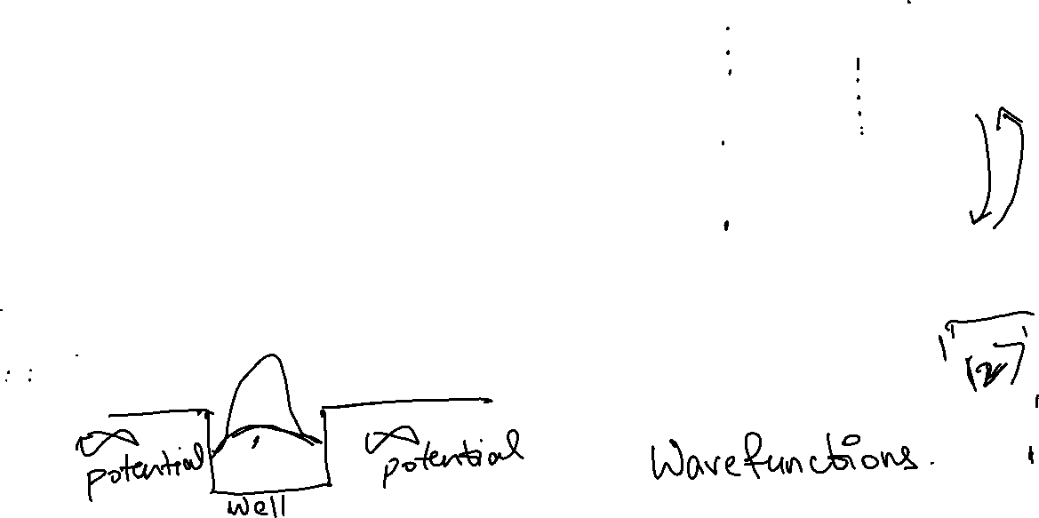
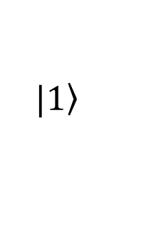
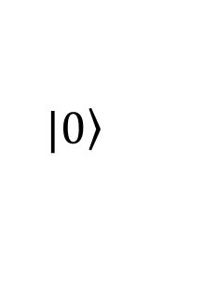
Enter the nanoworld
At small scales, everything (electrons/atoms/ions…) can behave as a wave
When they are confined, they show quantization, just like a string!
We can use the modes as qubit states
$$|\left.0\right\rangle$$
$$|\left.1\right\rangle$$
Ignore this and higher modes
Notes:
So why do we care about waves on guitar string? Well, in the nanoworld, everything behaves like this! We saw last week that everything behaves like a wave at the nanoscale. So, if we confine these waves, just like the waves on a guitar string, they can only take certain shapes! This phenomenon is known as quantization. Why is this important? Because we can use these modes as qubit states. You can imagine on the guitar string, we can use the first mode as 0, the second mode as 1, and ignore higher order modes.

Slide 15
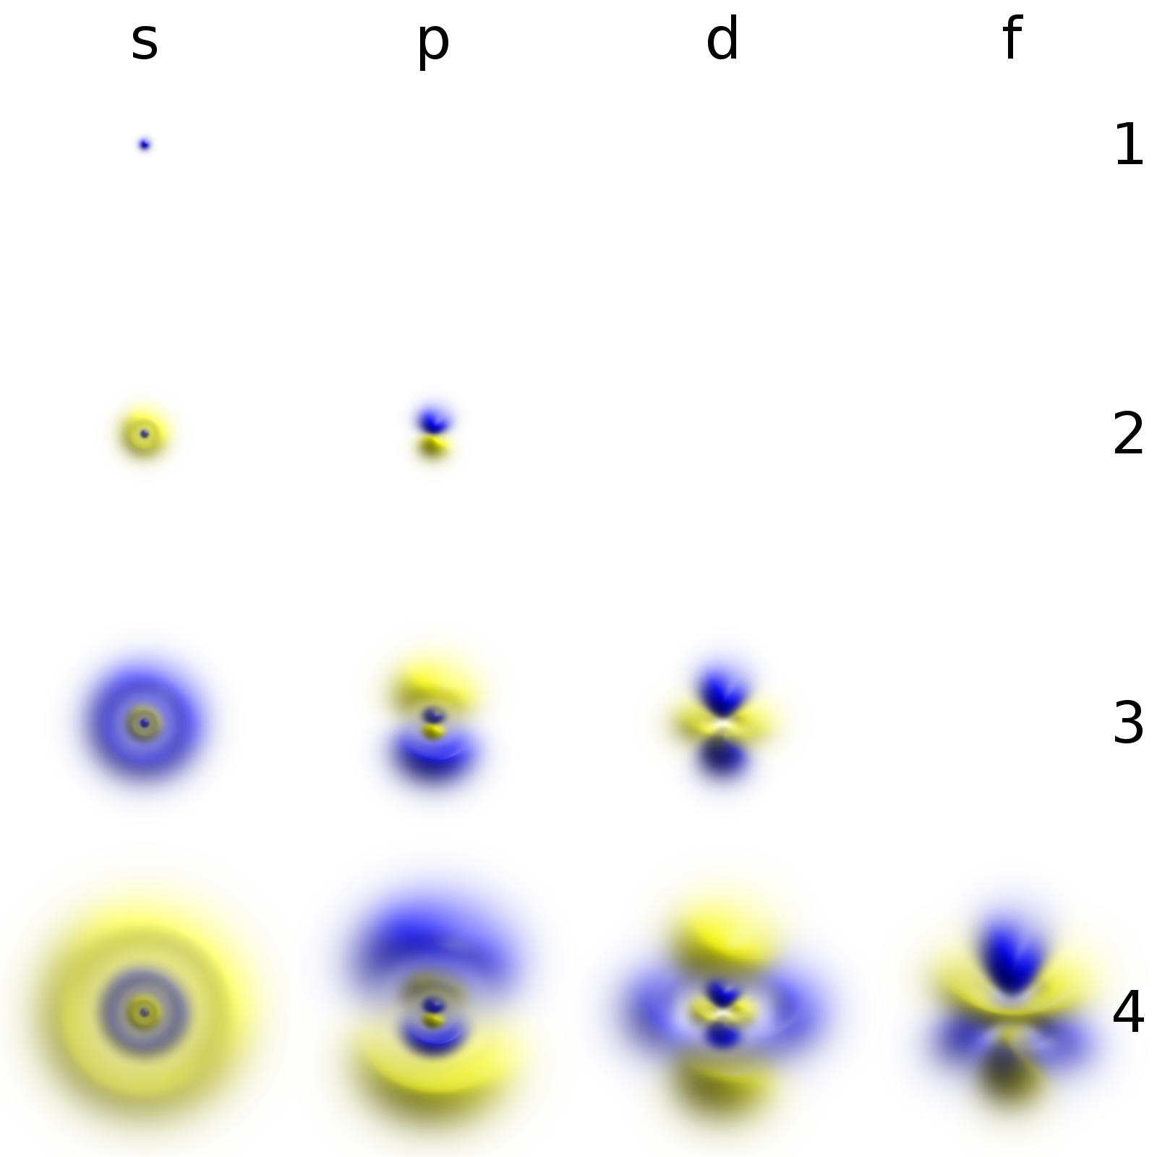
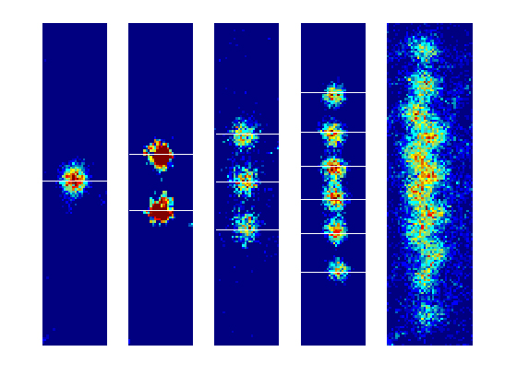
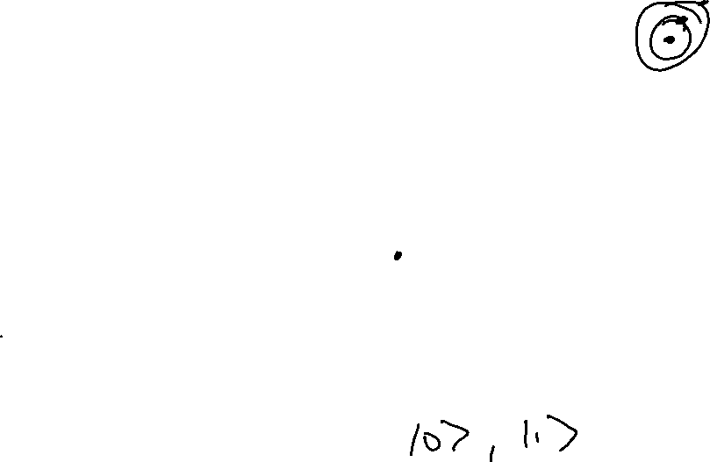
quantized systems in the nanoworld
Examples: electrons in atoms, trapped ions, diamond nitrogen vacancy centers
Challenges:
Keeping the qubit state ‘clean’
Minimizing impact of higher modes
Reducing noise from the environment
Ensuring reliable transfer between modes
…
Atomic orbitals
Trapped ions
Notes:
Here are some examples of nanoscale systems that show quantization – electrons in atoms, trapped ions, and diamond nitrogen vacancy centers.
Think about an electron in an atom. We saw that to create quantized states, we need confinement. Can you think of how or what is confining the electron in an atom?
We can also appreciate some of the challenges in QC – we need to keep the states ‘clean’, meaning that we don’t want a qubit in state 0 to change to 1 on its own. We also need to minimize the impact of the higher modes that we ignore. Part of this is reducing environmental noise. Also, we want to be able to reliably change the qubit state from 1 to 0 when we want to.

Slide 16
Questions?
Questions on content so far?

Slide 17
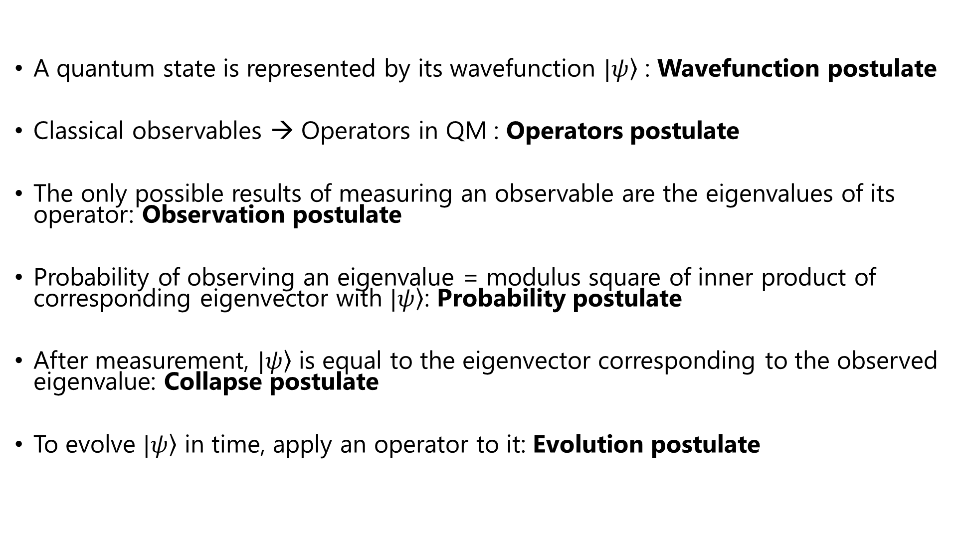
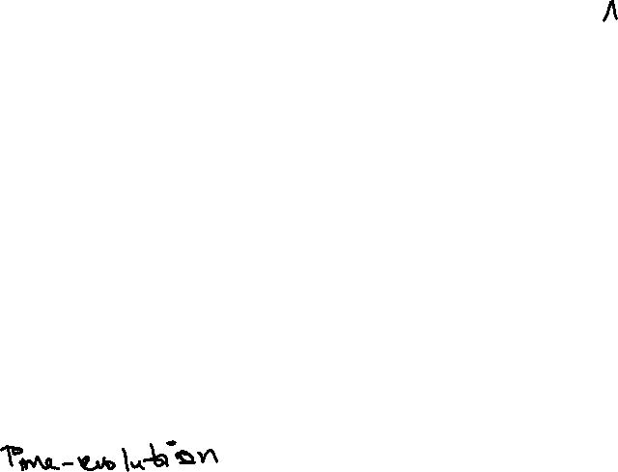
The postulates of QM
A quantum state is represented by its wavefunction $|\left.ψ\right\rangle$ : Wavefunction postulate
Classical observables → Operators in QM : Operators postulate
The only possible results of measuring an observable are the eigenvalues of its operator: Observation postulate
Probability of observing an eigenvalue = modulus square of inner product of corresponding eigenvector with $|\left.ψ\right\rangle$: Probability postulate
After measurement, $|\left.ψ\right\rangle$ is equal to the eigenvector corresponding to the observed eigenvalue: Collapse postulate
To evolve $|\left.ψ\right\rangle$ in time, apply an operator to it: Evolution postulate
Notes:
Here are the postulates you saw this week. We’ve given each one a name so we can recall them easily if needed.

Slide 18
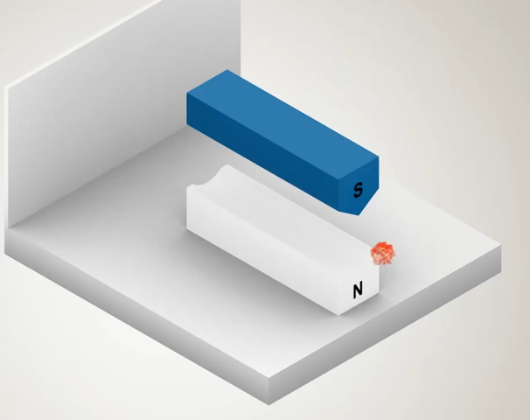
the stern Gerlach experiment
Since spin corresponds to a small magnetic field, we can use another magnet to measure it!
When measured, spin always has two directions – one along the direction of the magnetic field and one opposite to it
screen
Stern-Gerlach magnets
electron
Notes:
Let’s think about these postulates in the context of something we did last week – the stern Gerlach experiment. This slide is repeated from last week. Recall that in this experiment, when the spin is measured, we can only get two results – along the direction of the magnetic field and opposite to the direction of the field.

Slide 19
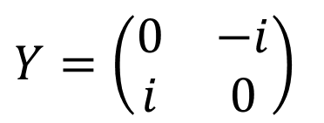
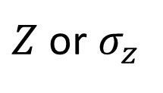
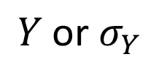
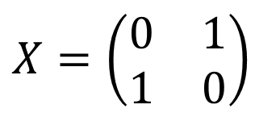
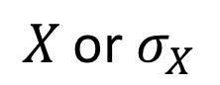
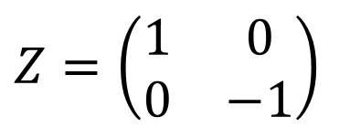
Measuring Spin - theory
Classical observables → Operators in QM : Operators postulate
In the Stern-Gerlach experiment, the observable is spin, and we can measure it along different directions
Observable
Operator
Matrix
Spin along z-axis
$Z$ or $σ_{z}$
$Z=\left(\begin{matrix}1 & 0 \\ 0 & −1\end{matrix}\right)$
Spin along x-axis
$$X \text{or} σ_{X}$$
$X=\left(\begin{matrix}0 & 1 \\ 1 & 0\end{matrix}\right)$
Spin along y-axis
$$Y \text{or} σ_{Y}$$
$Y=\left(\begin{matrix}0 & −i \\ i & 0\end{matrix}\right)$
Notes:
The operators postulate says that for every observable, there is an operator. In the SG experiment, we observe spin along different directions, and associated with this observable are operators. Here they are! There is a different operator for each of the three directions, and we can combine them to get operators for measuring spin along arbitrary directions.

Slide 20
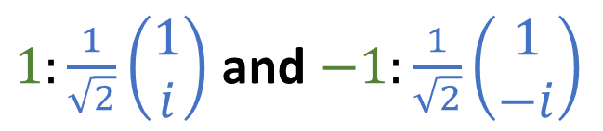
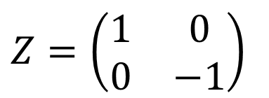
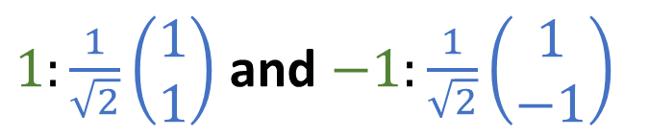
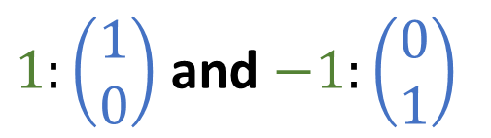
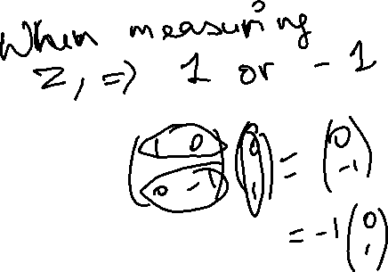
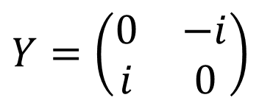
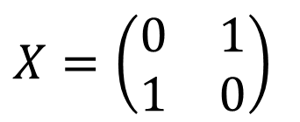
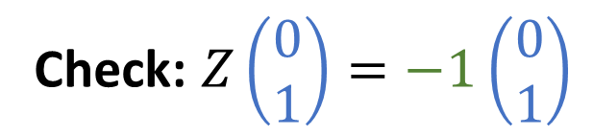
Measuring Spin - theory
The only possible results of measuring an observable are the eigenvalues of its operator: Observation postulate
Operator Matrix
Eigenvalues and eigenvectors
$Z=\left(\begin{matrix}1 & 0 \\ 0 & −1\end{matrix}\right)$
$1:\left(\begin{matrix}1 \\ 0\end{matrix}\right)$ and $−1:\left(\begin{matrix}0 \\ 1\end{matrix}\right)$
$X=\left(\begin{matrix}0 & 1 \\ 1 & 0\end{matrix}\right)$
$1:\frac{1}{\sqrt{2}}\left(\begin{matrix}1 \\ 1\end{matrix}\right)$ and $−1:\frac{1}{\sqrt{2}}\left(\begin{matrix}1 \\ −1\end{matrix}\right)$
$Y=\left(\begin{matrix}0 & −i \\ i & 0\end{matrix}\right)$
$1:\frac{1}{\sqrt{2}}\left(\begin{matrix}1 \\ i\end{matrix}\right)$ and $−1:\frac{1}{\sqrt{2}}\left(\begin{matrix}1 \\ −i\end{matrix}\right)$
Check: $Z\left(\begin{matrix}0 \\ 1\end{matrix}\right)=−1\left(\begin{matrix}0 \\ 1\end{matrix}\right)$
Notes:
Now, remember the observation postulate – the only possible outcomes of experiments are the eigenvalues of the corresponding operator. Let’s take a look at the eigenvalues and eigenvectors of the operators we introduced on the last slide. According to this postulate, the only possible values we can get when we measure spin are +1 and -1. This makes sense - +1 is along the direction and -1 opposite to the direction of the field! So far so good.
Associated with each eigenvalue is an eigenfunction – this is the vector to which the operator is applied to get the eigenvalue.

Slide 21
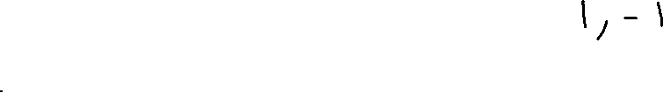
Measuring Spin - theory
Operator Matrix
Eigenvalues and eigenvectors
$Z=\left(\begin{matrix}1 & 0 \\ 0 & −1\end{matrix}\right)$
$1:\left(\begin{matrix}1 \\ 0\end{matrix}\right)$ and $−1:\left(\begin{matrix}0 \\ 1\end{matrix}\right)$
Problem 1: What are the possible outcomes of measuring spin along the z-axis?
Hint: Think about the Observation postulate
Notes:
Two possible results (eigenvalues) - +1 and -1

Slide 22
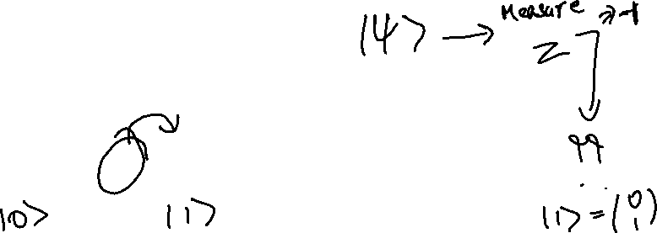
Measuring Spin - theory
Operator Matrix
Eigenvalues and eigenvectors
$Z=\left(\begin{matrix}1 & 0 \\ 0 & −1\end{matrix}\right)$
$1:\left(\begin{matrix}1 \\ 0\end{matrix}\right)$ and $−1:\left(\begin{matrix}0 \\ 1\end{matrix}\right)$
Problem 2: The result of a measurement of spin along the z-axis is -1. What is the wavefunction of the electron immediately after the measurement?
Hint: Think about the collapse postulate
Notes:
The eigenvectors of the corresponding eigenvalues give us the state of the qubit after measurement.

Slide 23
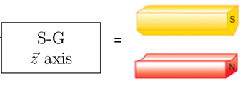
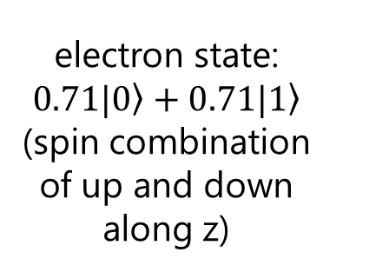
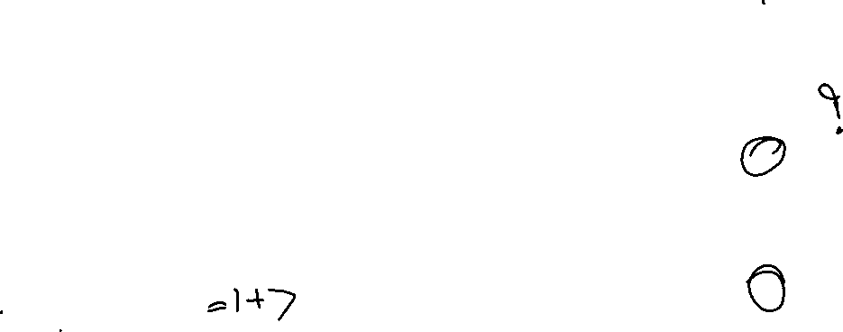
Measuring spin - example
Where does the electron go?
z-axis
1
4
2
5
x-axis
electron state: $0.71|\left.0\right\rangle +0.71|\left.1\right\rangle$
(spin combination of up and down along z)
3
Notes:
Here’s an example that we saw last week. First, let’s think about this in terms of the experiment.
What if the state was a combination of up and down? We know that such combination or superposition states are what make qubits special. Where would this electron go?
We can’t predict the result of this experiment! We can only say that the electron would go to 1 with prob. ½ and to 3 with prob. ½. Point out that it would be true for any combination – always get either 1 or 3.

Slide 24
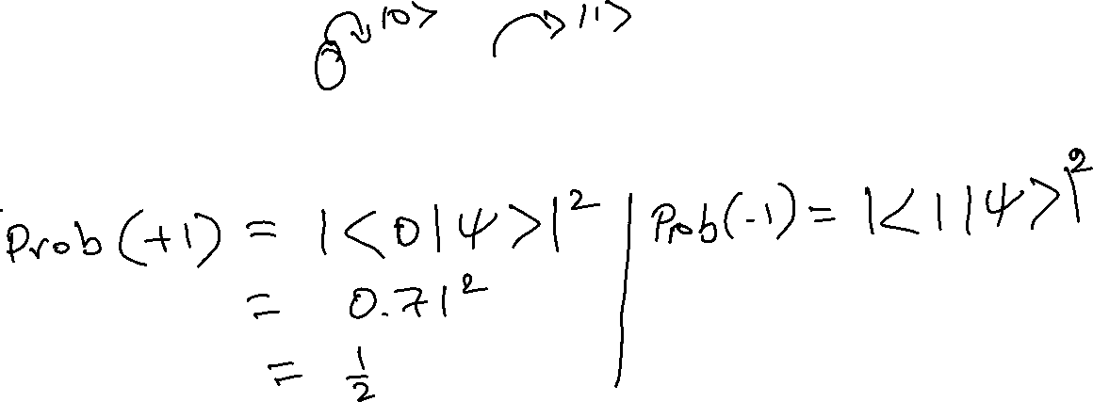
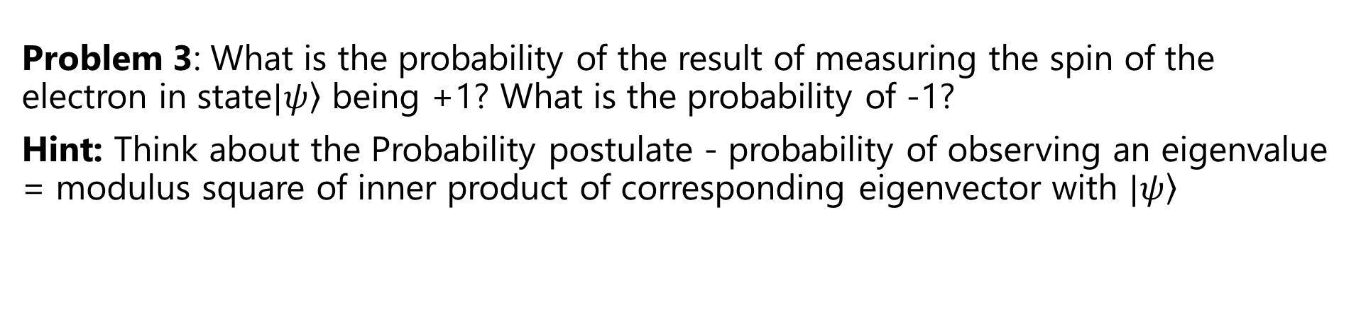

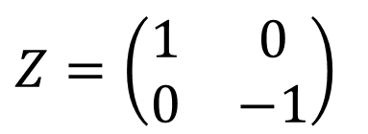
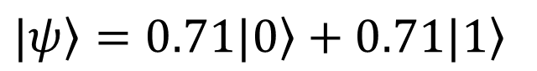
Measuring spin - example
$|\left.ψ\right\rangle =0.71|\left.0\right\rangle +0.71|\left.1\right\rangle$
Operator Matrix
Eigenvalues and eigenvectors
$Z=\left(\begin{matrix}1 & 0 \\ 0 & −1\end{matrix}\right)$
$1:\left(\begin{matrix}1 \\ 0\end{matrix}\right)$ and $−1:\left(\begin{matrix}0 \\ 1\end{matrix}\right)$
Problem 3: What is the probability of the result of measuring the spin of the electron in state$|\left.ψ\right\rangle$ being +1? What is the probability of -1?
Hint: Think about the Probability postulate - probability of observing an eigenvalue = modulus square of inner product of corresponding eigenvector with $|\left.ψ\right\rangle$
Notes:
Now, let’s think about the theory. We take the same state. What is the probability of the result of measuring the spin of the electron in state$|\left.ψ\right\rangle$ being +1? What is the probability of -1? Think about the collapse postulate.

Slide 25
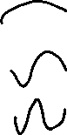
Key Takeaways
When a system that shows wave-like behavior is confined, the wave modes get quantized
At the scale of electrons/atoms/ions, everything shows wave-like behavior. Therefore, everything shows quantization when it is confined!
The postulates of quantum mechanics are the rules that quantum systems are observed to follow

Slide 26
Further Reading and resources
https://www.st-andrews.ac.uk/physics/quvis/simulations_html5/sims/infwell1d/infwell1d.html - Simulation of the quantum version of a guitar string – the particle in a box
http://web.mit.edu/8.05/handouts/jaffe1.pdf - Lecture notes from Prof. R. L. Jaffe at MIT, discussing the QM postulates along with linear algebra
https://www.youtube.com/watch?v=uK2eFv7ne_Q – Lecture 1 of a series of lectures by Prof. R. Shankar on QM
https://youtu.be/Sut0Aegyoes – Brief video on transmission electron microscopy

Slide 27
Questions?
Questions on content so far?

Slide 28
Post-LAB Zoom FEEDBACK
After this lab, on a scale of 1 to 5, how would you rate your understanding of this week’s content?
1 –Did not understand anything
2 – Understood some parts
3 – Understood most of the content
4 – Understood all of the content
5 – The content was easy for me/I already knew all of the content

Slide 29
Optional content

Slide 30
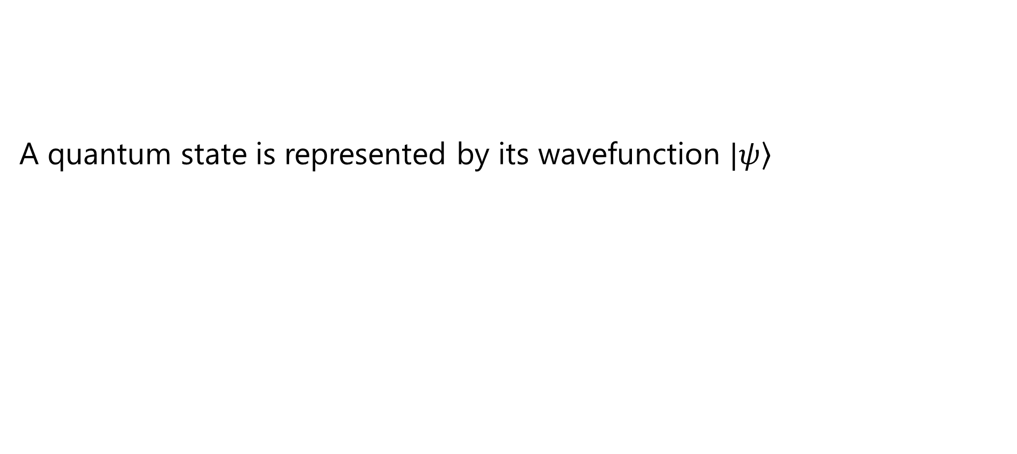
Wavefunction postulate
A quantum state is represented by its wavefunction $|\left.ψ\right\rangle$
Notes:
Let’s revisit the wavefunction postulate

Slide 31
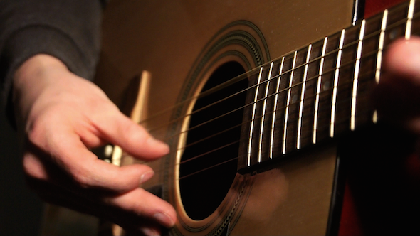
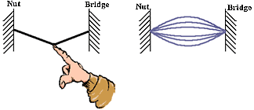
Let’s pluck these strings!
When we pluck a guitar string, we create a ripple in it
Notes:
Let’s think of this in terms of the guitar again. Now, we’re going to plunk the string – we’re going to force the string to be in a shape that it wouldn’t normally be in by itself

Slide 32

The Guitar “Wavefunction”
The shape of the string describes everything about it
The string shape is its “wavefunction”
string
nut
bridge
Notes:
When we do this, we can think of the shape of the string as its “wavefunction”. The shape of the string describes what it will sound like. On the right are a couple of cartoons showing what the plucked string might look like.

Slide 33
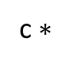
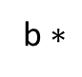
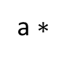
Describing the Ripple With eigenfunctions
The ripple can be “reconstructed” by adding up the modes
a $∗$
+
actual shape of string
=
b $∗$
+
fixed
fixed
c $∗$
+ ….
Notes:
Now here’s a really cool result – it turns out that you can describe any of these shapes that you force the string into, as a combination of the same modes that we saw earlier! The ripple that we create can be reconstructed by adding up the different modes.

Slide 34
Describing the ripple with eigenfunctions
string
Notes:
Let’s see an example of this – here again is the same shape of the plucked string with a ripple on it.
From the next slide, we’ll be showing the different modes on the right hand side of the slide.

Slide 35
Describing the Ripple With eigenfunctions
mode 1
string
Sum of modes
modes
With just the first mode, the match is not very good
Notes:
And now here’s the first mode. On the right hand slide is just the first mode, and on the left we’ll be showing the sum of the modes as we add more and more in.
Not a very good match, is it?

Slide 36
Describing the Ripple With eigenfunctions
mode 1
string
Sum of modes
mode 2
modes
As we increase the number of modes, the match improves!
Notes:
Let’s add in the second mode as well. Now, the sum looks a little bit better. On the right, you can see the two modes. The relative heights of the modes reflects their contribution to the sum.

Slide 37
Describing the Ripple With eigenfunctions
mode 1
string
mode 3
Sum of modes
mode 2
modes
As we increase the number of modes, the match improves!
Notes:
Let’s add a third mode. Its getting better!

Slide 38
Describing the Ripple With eigenfunctions
string
Sum of modes
modes (first 5)
As we increase the number of modes, the match improves!
Notes:
Here’s the sum with the first 5 modes. Getting much better! You can also see that the contribution of the modes is reflected in their relative heights.

Slide 39
Describing the Ripple With eigenfunctions
string
Sum of modes
modes (first 8)
As we increase the number of modes, the match improves!
Notes:
Here’s the sum with 8 modes. Much better! We’ve got a pretty good match already. You can see that te contribution of the higher order modes is reducing as the match gets better and better.

Slide 40
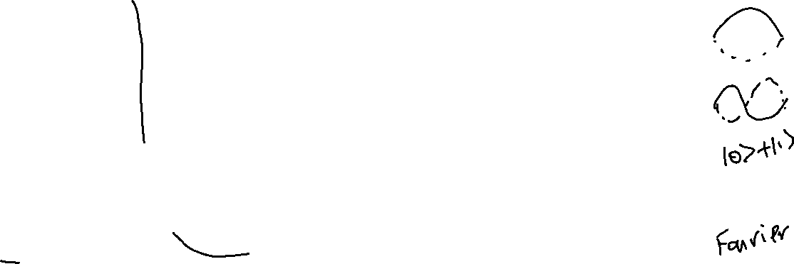
Describing the Ripple With eigenfunctions
Superposition
string
Sum of modes
modes (first 10)
As we increase the number of modes, the match improves!
Notes:
Now with 10 modes. Almost perfect. We can keep adding modes and the match gets better and better.
This is exactly superposition! We are adding up the eigenfunctions or modes to describe the string’s wavefunction

Slide 41





Mode superposition
On a string
In a qubit
a $∗$
+
actual shape of string
$|\left.ψ\right\rangle =0.71|\left.0\right\rangle +0.71|\left.1\right\rangle$
=
b $∗$
+
c $∗$
+ ….
This method of expressing a function as a superposition of modes is known as Fourier analysis
Notes:
What we just did is an example of Fourier analysis.

Slide 42

OBSERVATION POSTULATE
The only possible results of measuring an observable are the eigenvalues of its operator
On the guitar: If you try to see the string, you will only see one of the modes, not the ripple

Slide 43


Probability postulate
Probability of observing an eigenvalue = modulus square of inner product of corresponding eigenvector with $|\left.ψ\right\rangle$
On the guitar: When you see the string, the probability of seeing a mode depends on its contribution to the initial wavefunction (the ripple when you pluck the string)

Slide 44


Collapse postulate
After measurement, $|\left.ψ\right\rangle$ is equal to the eigenvector corresponding to the observed eigenvalue
On the guitar: After you see the guitar string, it remains in the mode you observed

